Slide 1


Wireframe And Estimation For Data Visualization
By Shaikh Rabiya

Slide 2


Cost Estimation
SR.NO | Activity Performed | Cost/HR In INR | Hours
1 | Understanding & Studying Data | 300 | 2
2 | Cleaning & Extracting Information | 450 | 1
3 | Creating Dashboard & Story | 600 | 2
4 | Come up with the insight | 400 | 1
 |  | Total | Rs. 2,650

Slide 3
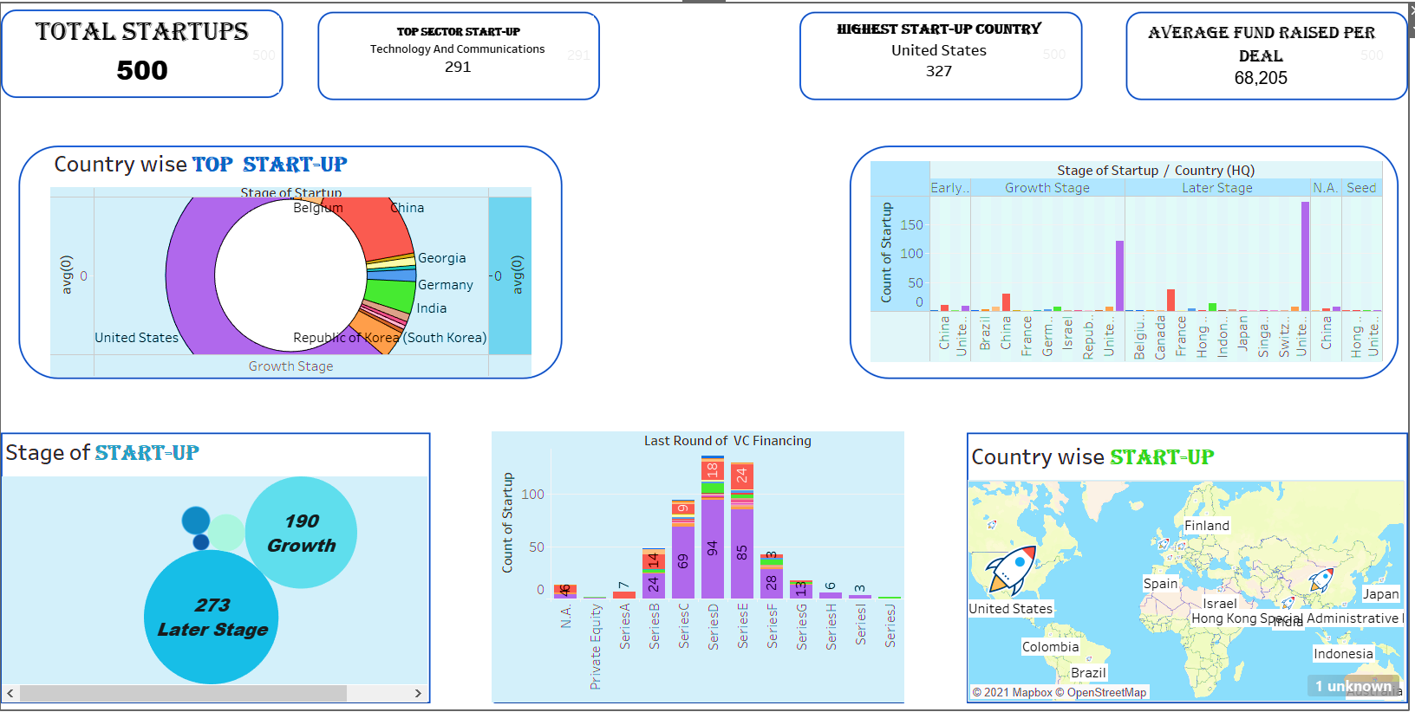

Wireframe

Slide 4
Few Insights
United States is the Top Start-up country
Most Start-ups is in the field of Technology and Communications.
Most of the start-ups is initiated in the later stage.
.

